Slide 1



Agenda
Inauguration and toss for the 1st Match By Rev.Fr.K.Sleeva Reddy @ 7.30 AM
First Match between Honey Bees Vs Crazy 11 @ 8.00 AM
Second Match between NBJ Blue Hawks Vs Panthers
Pls support, share and
https://youtube.com/@nbjparishsports

Slide 2
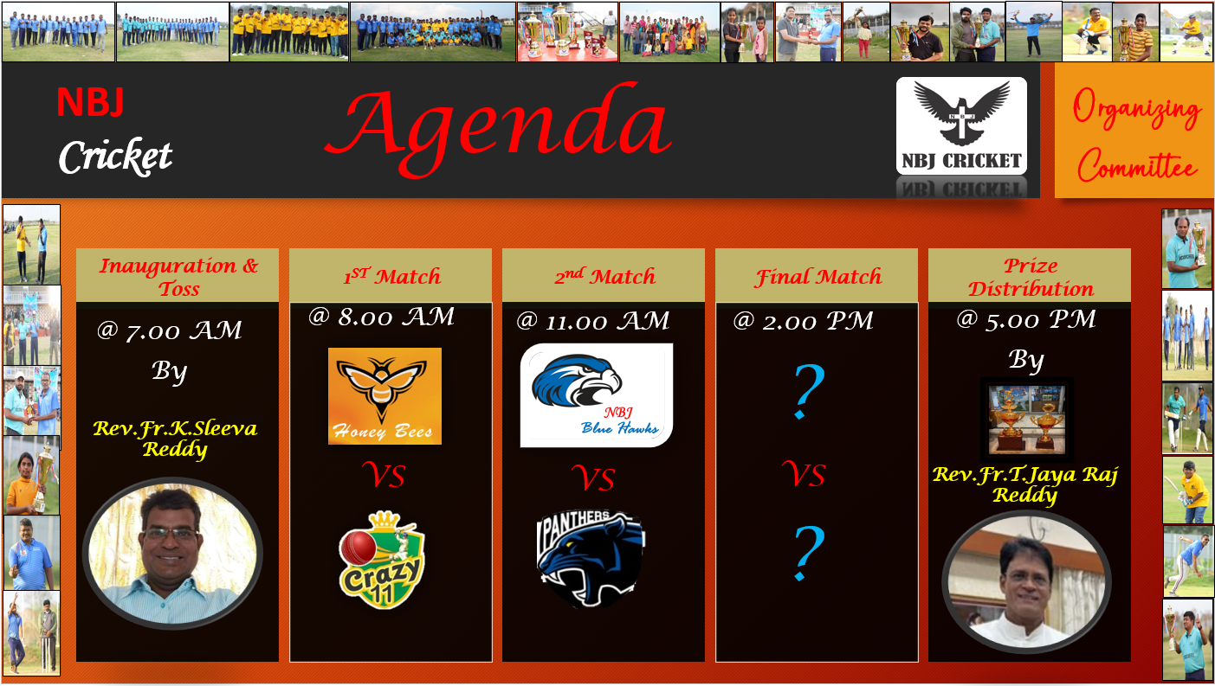
Thank you
Mirjam Nilsson​
mirjam@contoso.com
www.contoso.com

